Slide 1



B-tech Project Portal For IT Department
Members:
Atharva Kitkaru (1814033)
Nishavak Naik (1814040)
Jill Shah (1814055)
Mentor:
- Anooja Joy

Slide 2

Types of Users
Student
Guide
Coordinator

Slide 3
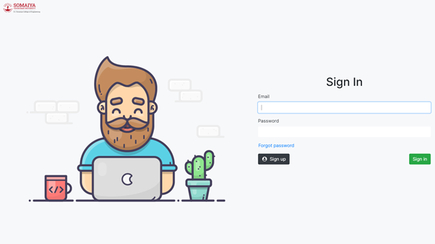
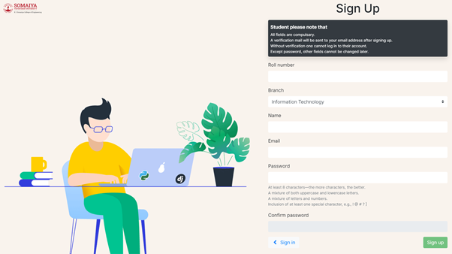


Authentication

Slide 4
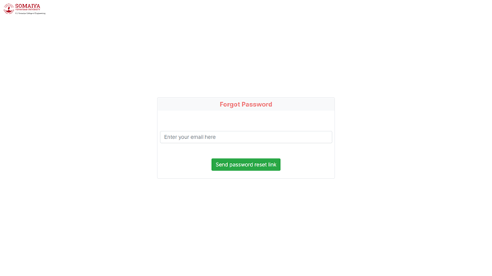
Authentication

Slide 5
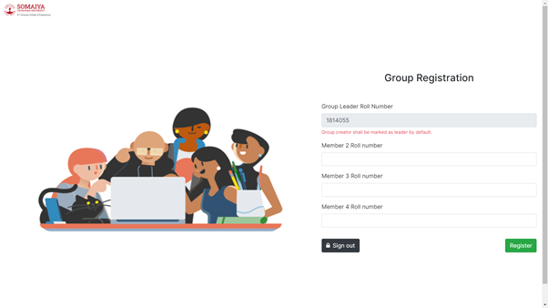
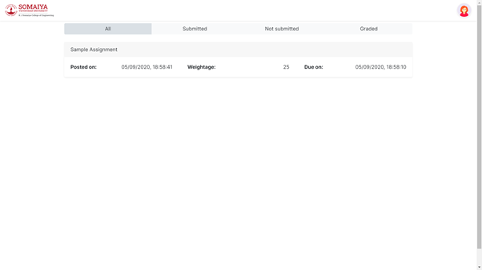
Student

Slide 6
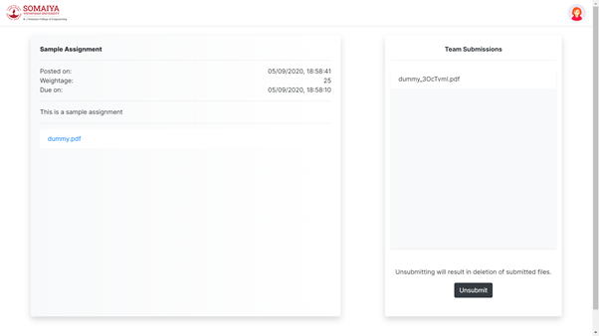
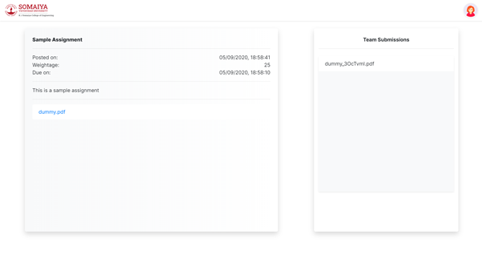
Student

Slide 7
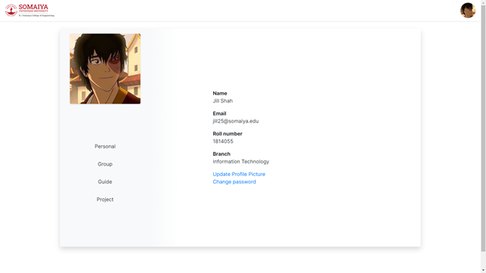
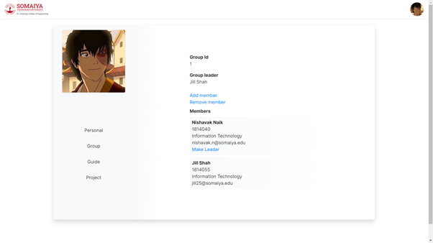
Student

Slide 8
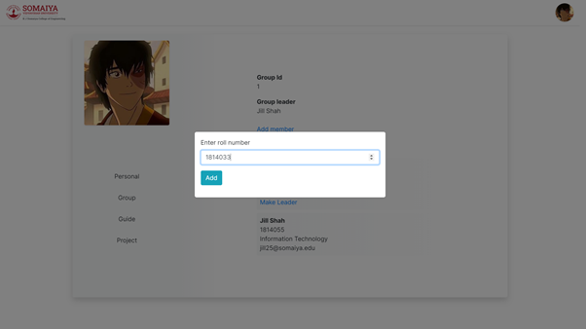
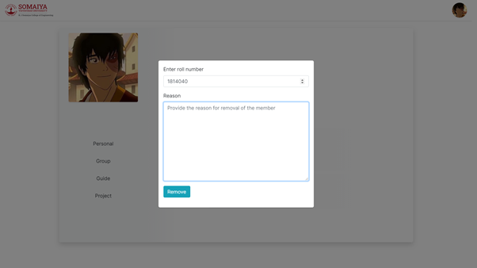
Student

Slide 9
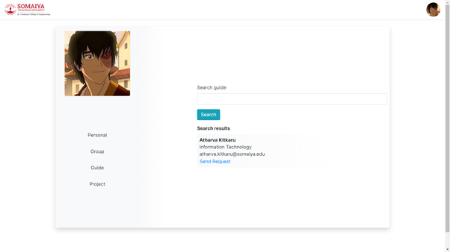
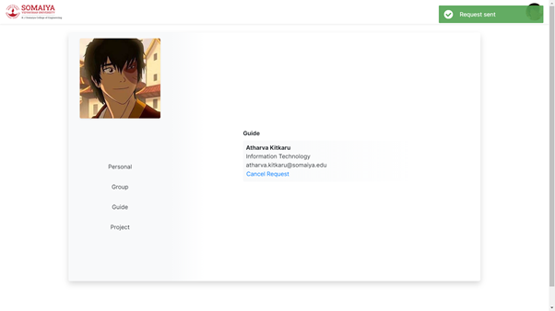
Student

Slide 10
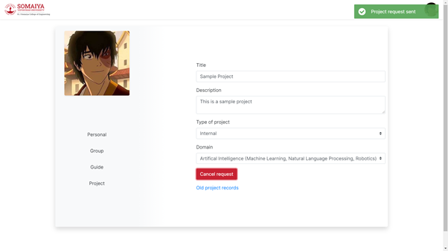
Student

Slide 11
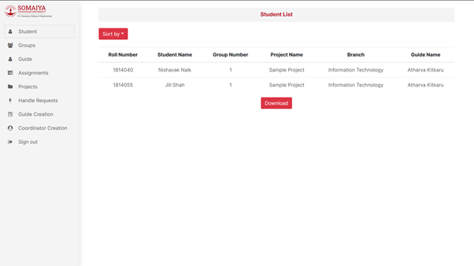
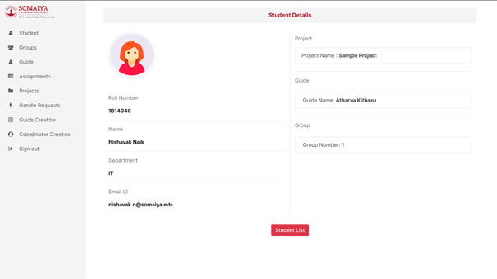
Coordinator

Slide 12
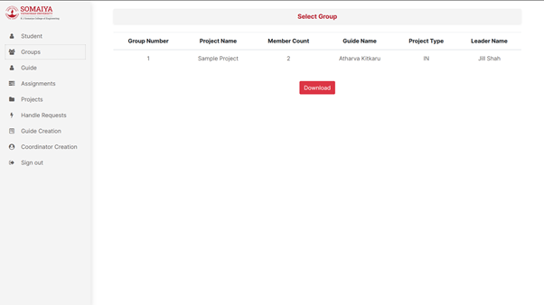
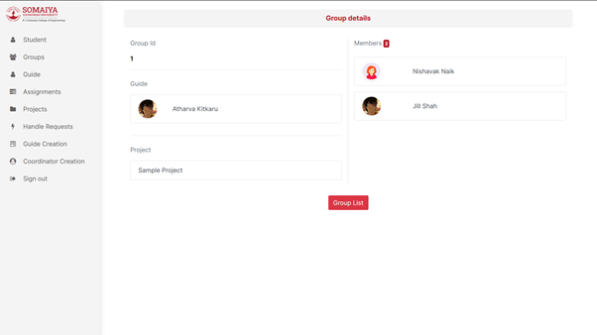
Coordinator

Slide 13
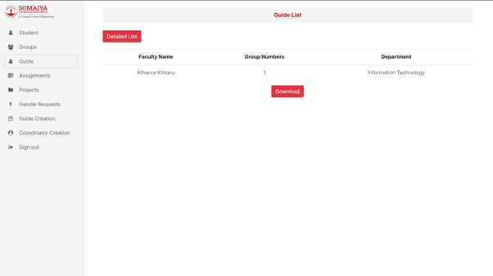
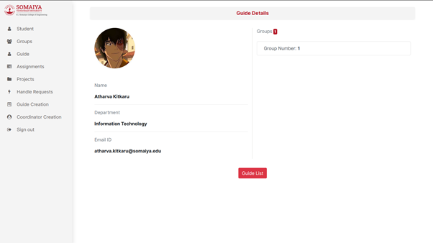
Coordinator

Slide 14
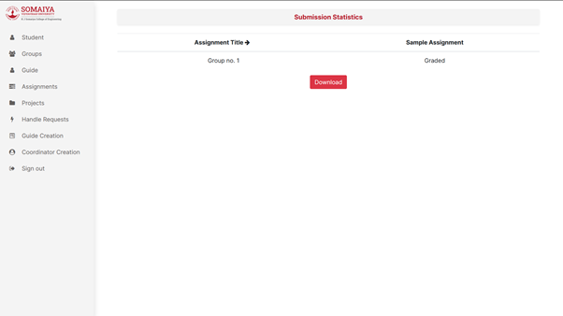
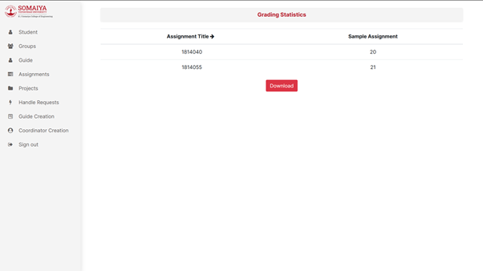
Coordinator

Slide 15
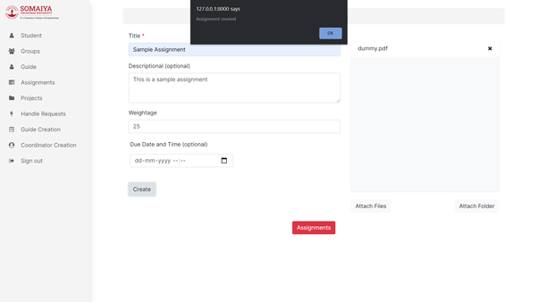
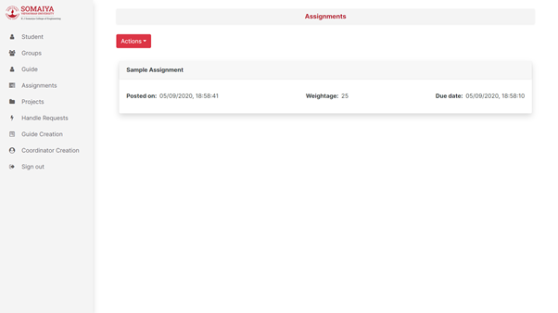
Coordinator

Slide 16
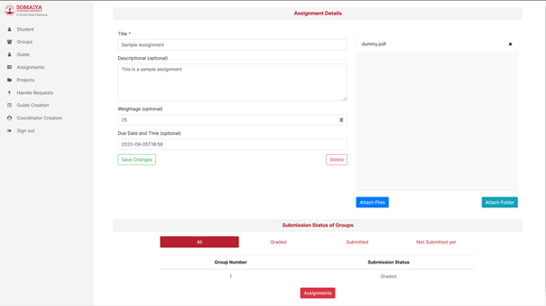
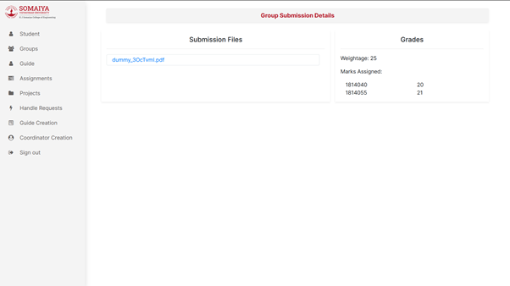
Coordinator

Slide 17
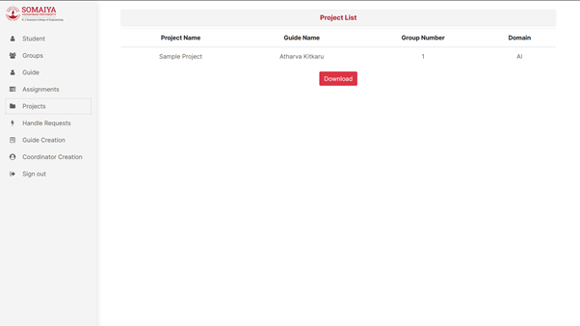
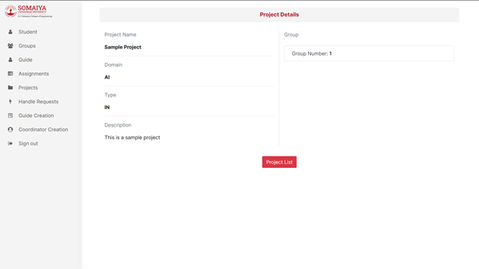
Coordinator

Slide 18
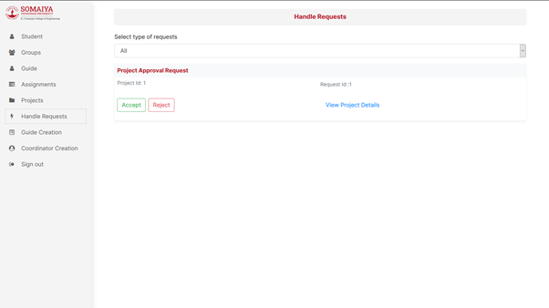
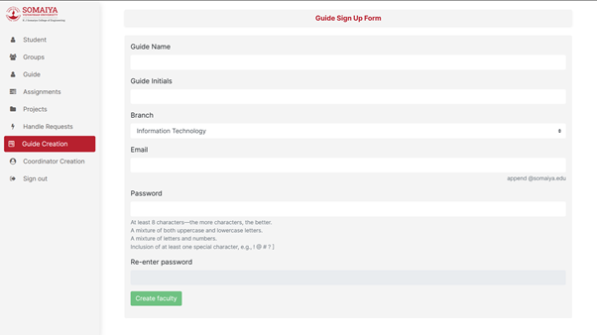
Coordinator

Slide 19
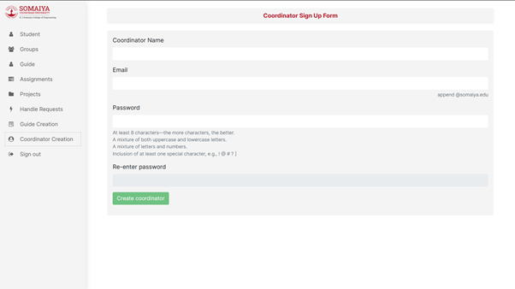
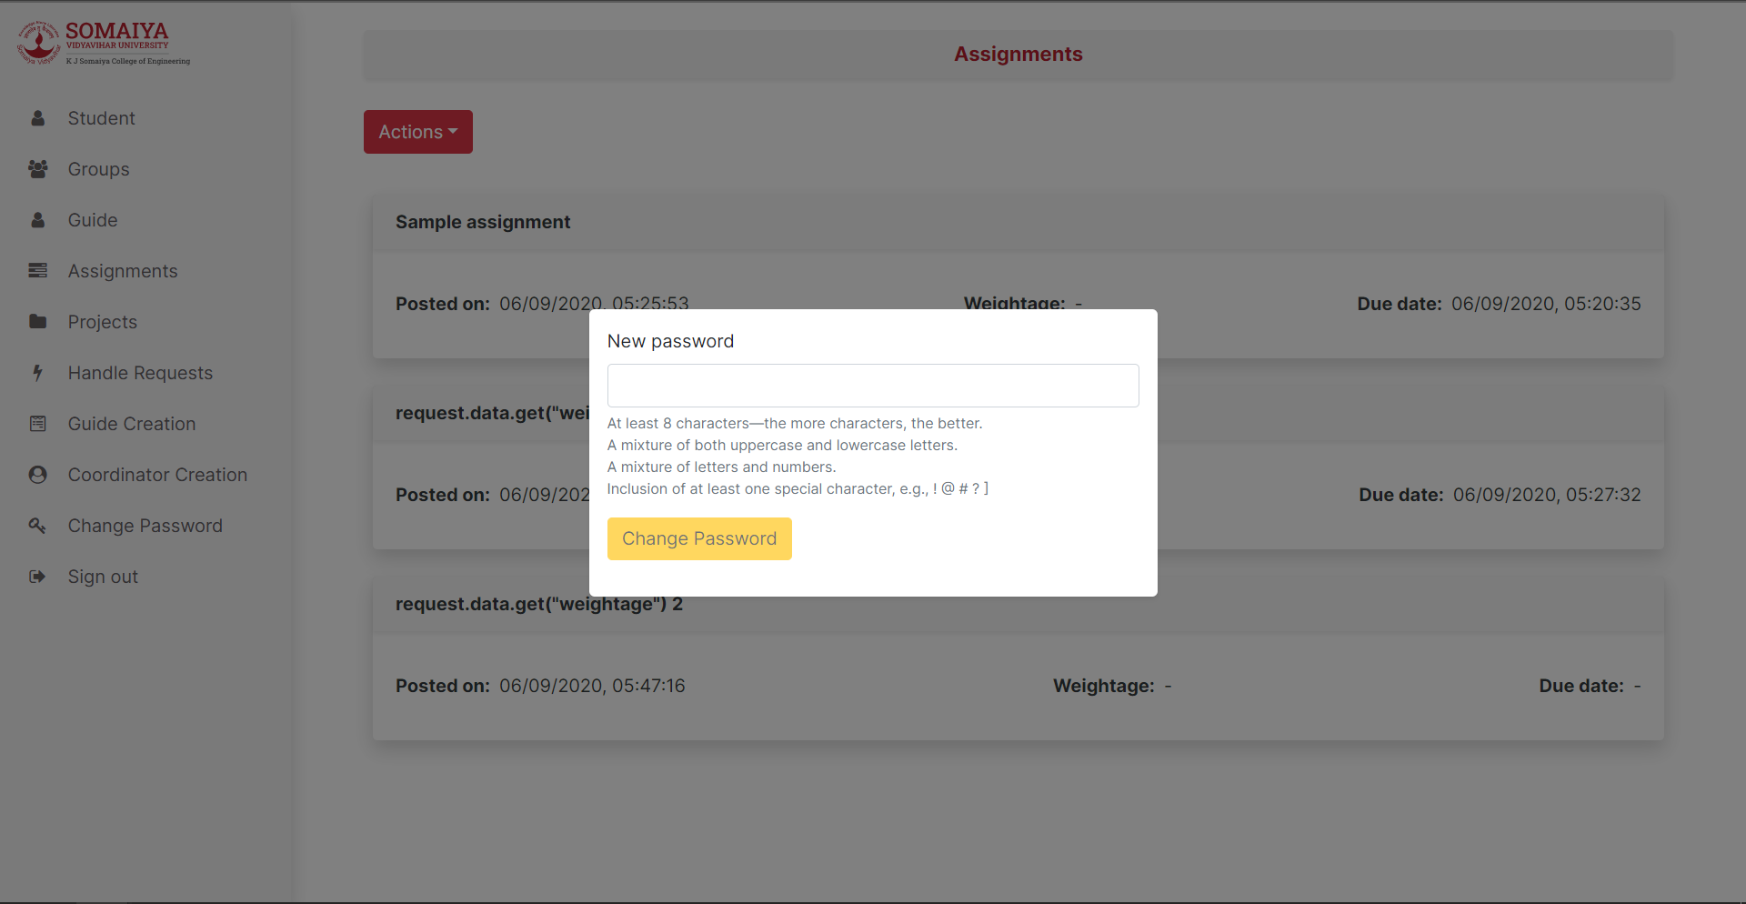
Coordinator

Slide 20
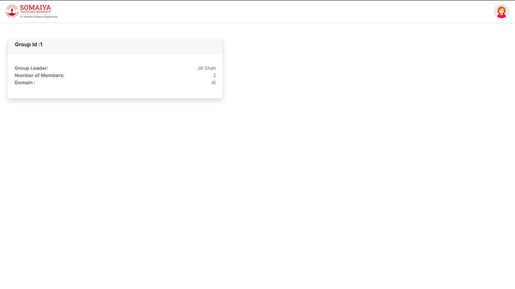
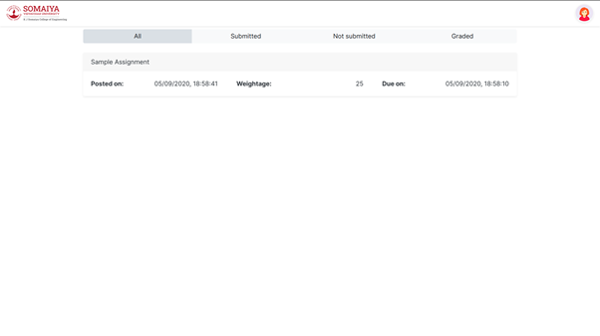
Guide

Slide 21
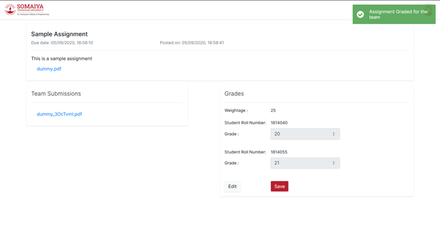
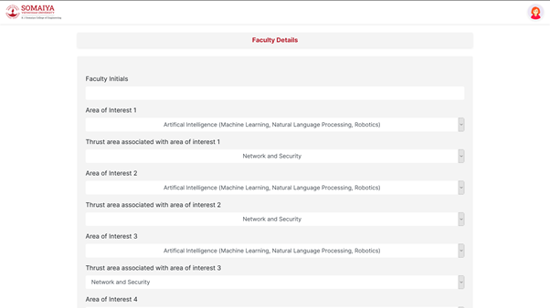
Guide

Slide 22
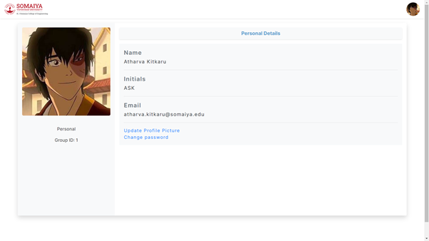
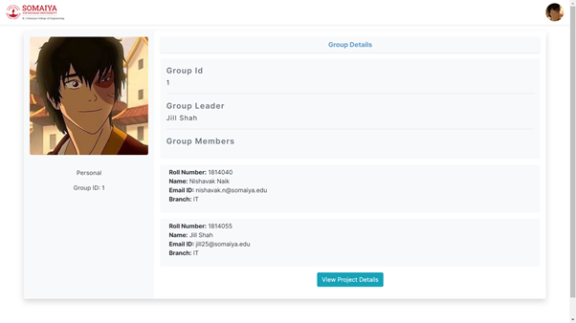
Guide

Slide 23

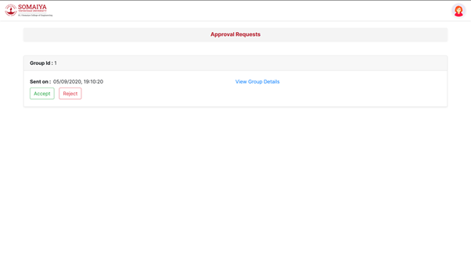
Guide

Slide 24
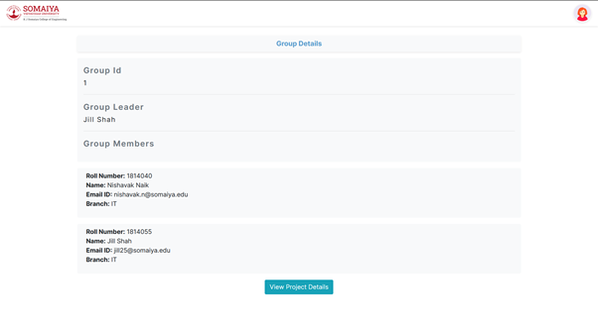
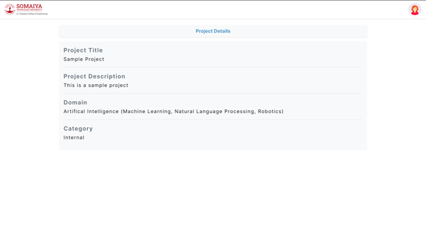
Guide

Slide 25
Student Features
The student has to first sign up with valid credentials. After signing up , a verification email will be sent to student
After verifying the email ,the student now can login using his credentials. In case if a student forgets his password , we have provided a forgot password option to reset his password
After signing in , the student will be redirected to group registration , IF he is not in a group already
On group registration page ,the student enters his roll number as well as the roll number of his other team mates. A team can contain minimum 1 and maximum 4 members. Before the group is accepted ,a backend check will be ...

Slide 26
Student Features
… done to verify if the mentioned students are already in a team or not
If the team registration is successful , the student will be redirected to the dashboard which is the assignment list page .The team registration page will only be shown to students who are not in a team already
The dropdown on the top right of the page contains the options : dashboard(assignment list) , profile , signout
The dashboard (assignment list page ) contains a list of assignments which can be categorized into submitted , not submitted and graded assignments. All category ...
...

Slide 27
Student Features
… contains list of all assignments irrespective of their status
On Clicking on individual assignments ,the student is shown the assignment details page which contains the the details of the assignment as well as option to upload files for submissions
Everyone in the group can view the details as well as the files submitted , but the right to upload or modify files is only with the team leader .
On clicking on the profile option in the dropdown , the student will be redirected to the profile page
The profile page contains a sidebar , which has user pic ...

Slide 28
Student Features
… at the top and personal , group/team , guide and project navigation options
On clicking on the personal option , the student can see his personal details , change his profile picture and his password if needed
The Group / team section contains the details of the team of which the student is a part of .The leader of the team has the additional option to send a request to the coordinator to remove any member , or change the leader of that team. Corresponding action will be taken based on the decision of the coordinator. New members can be added to the group...

Slide 29
Student Features
… by the leader , without any need to send a request to the coordinator
In the guide section of profile page , the student can see the details of the guide of that team , if that team already has a guide . If that team has no guide, then the students will be shown a search option for guide and the leader can send only one request to only one person whom they want as their guide. The request can also be cancelled later . In case the guide accepts the request ,that guide will be alloted to that team. In case of rejection , the team can send a new request .

Slide 30
Student Features
In the project section of the profile , the students will be shown the details of their project .If they haven’t registered their project yet , then the leader can fill up the project form and send a request to the coordinator to approve the project . If the coordinator rejects the project ,then the request will be deleted and the leader has to send a new request again .
The team can also see the list of previous year projects
In case of an interdisciplinary project ,a new field will be enabled which asks for the explanation

Slide 31
Guide Features
Guide login credentials will be provided by the coordinator. Guide has to first change password and then sign in.
A dashboard appears after the guide has signed in which shows the group cards in which the guide is assigned.
Guide navbar has a profile picture at the right corner, which is a drop down which contains links for the profile, dashboard, details form, the guide requests and the signout button.
The guide requests link has all the requests which leader will send for his/her group to that guide. The guide can accept or reject the group request. The guide can accept maximum two group requests. After the guide has accepted two group requests, the page will disappear from the header.

Slide 32
Guide Features
The group request card has the group id, group leader name and a link to view the group details.
The group details page has a button to view the project details for that particular group.
The details form has the options to fill the initials of the, area of interest and thrust areas associated with the area of interests of the guide. All fields are compulsory.
On clicking the group card on the dashboard, the guide will be taken to the assignment list page. This page consists of tabs categorized as All, Submitted, Graded, Not Submitted assignments.

Slide 33
Guide Features
There are assignments will be in card form under each tab. It will have the assignment title, assignment due date, date on which the assignment is posted and the weightage.
On clicking the particular assignment, a page showing the details of assignment like those on card, the description, the attachments by coordinator, the attachments by team is opened. This page also has a grading section where the guide can assign grades to each student of the team for that assignment.
Profile page has a sidebar which has a profile picture of the guide and other sections like personal and the group ids.

Slide 34
Guide Features
On clicking the personal section, guide‘s personal details are displayed and the links to change password and profile picture are given.
On clicking the group id on the sidebar, the group details are shown and a button to view the project details is given.
On clicking that button the project details of the team is displayed.

Slide 35
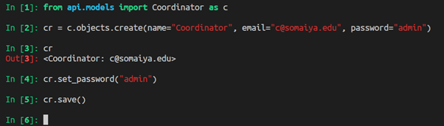
Co-ordinator Features
Creation of first coordinator using shell

Slide 36
Co-ordinator Features
Coordinator can view student , group , project and guide lists as well as their details page . They can also download these lists
Coordinator can create assignments , view assignment list , view and edit details , and team submissions as well as grades associated with that assignment
They can also view and download the submission statistics of all groups and grading statistics of all students
Coordinators are responsible for creating guides as well as other coordinators

Slide 37
Co-ordinator Features
Coordinators handle group as well as project requests
Group requests include requests for removal of team members or changing the leader
Project requests include requests for approving the projects

Slide 38
THANK YOU

